Slide 1

Numeral Systems
Mina Gabriel

Slide 2
Numbers
Natural Numbers
  Zero and any number obtained by repeatedly adding one to it.
  Examples: 1, 1000, 45645, 32
Negative Numbers
  A value less than 0, with a – sign
  Examples: -44, -10, -4445, -5

Slide 3
Numbers
Integers
  A natural number, a negative number, zero
  Examples: 249, 0, -45645, -32
Rational Numbers
  An integer or the quotient of two integers
  Examples: -249, -1, 0, 3/7, -2/5

Slide 4
The Binary Numeral System – Foundation of Computing Technology
The binary numeral system is the system, which is used to represent and process numbers in modern computing machines. The main reason it is so widely spread is explained with the fact that devices with two stable states are very simple to implement and the production costs of binary arithmetic devices are very low.

Slide 5
The binary digits 0 and 1 can be easily represented in the computing machines as "current" and "no current", or as "+5V" and "-5V".
Along with its advantages, the binary system for number notation in computers has its drawbacks, too. One of its biggest practical flaws is that numbers represented in binary numeral system are very long, meaning they have a large number of bits. This makes it inconvenient for direct use by humans. To avoid this disadvantage, systems with larger bases are used in practice.

Slide 6
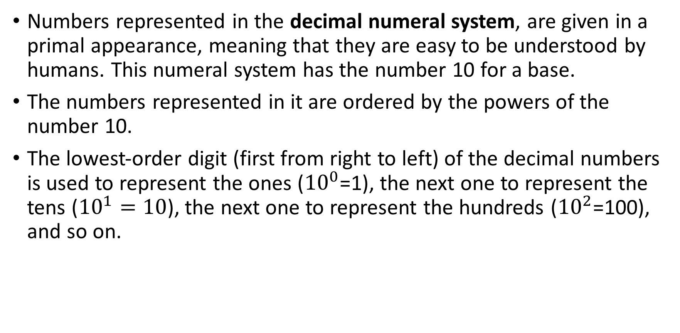
Decimal Numbers
Numbers represented in the decimal numeral system, are given in a primal appearance, meaning that they are easy to be understood by humans. This numeral system has the number 10 for a base.
The numbers represented in it are ordered by the powers of the number 10.
The lowest-order digit (first from right to left) of the decimal numbers is used to represent the ones (${10}^{0}$=1), the next one to represent the tens (${10}^{1}=10$), the next one to represent the hundreds (${10}^{2}$=100), and so on.

Slide 7
In other words – every following digit is ten times bigger than the one preceding it. The sum of the separate digits determines the value of the number. We will take the number 95031 as an example, which can be represented in the decimal numeral system as:

Slide 8
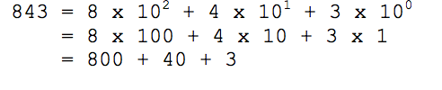
When we write decimal (base 10) numbers, we use a positional notation system. Each digit is multiplied by an appropriate power of 10 depending on its position in the number:
For example:

Slide 9
Exercise
What is the base 10 positional notation of the following numbers:
  642
  0
  9563
  -152
  7785124

Slide 10

Binary Numbers
The numbers represented in the binary numeral system are represented in a secondary aspect – which means that they are easy to be understood by the computing machine.
They are a bit harder to be understood by people.
To represent a binary number, the binary numeral system is used, which has the number 2 for a base.

Slide 11
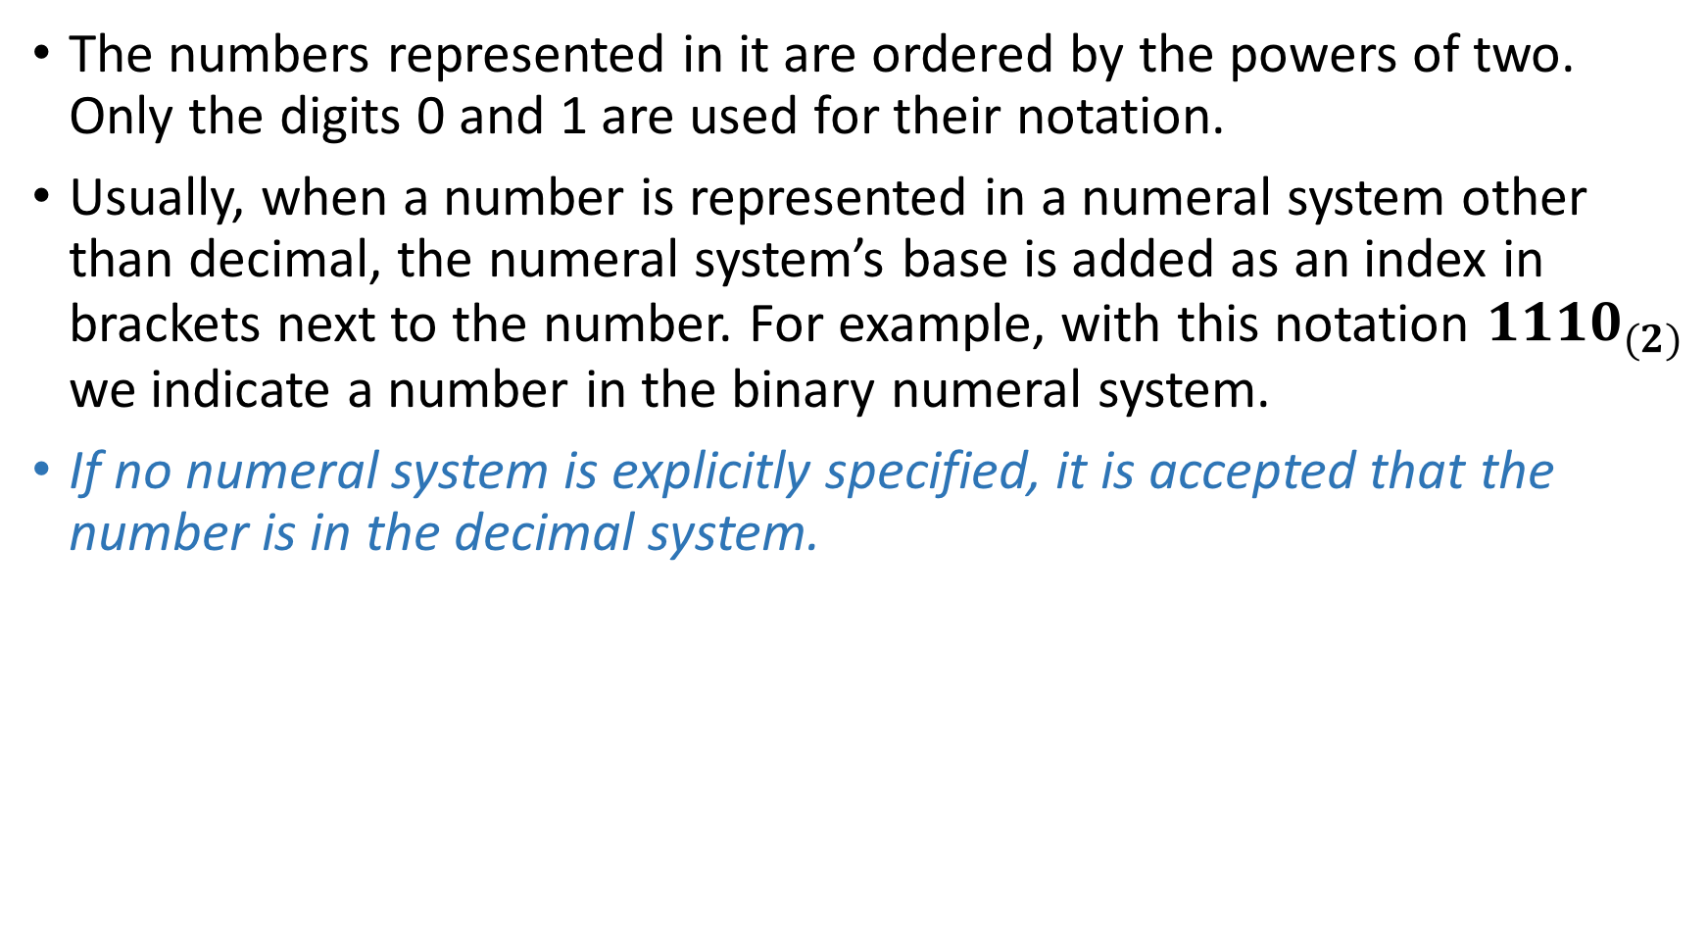
The numbers represented in it are ordered by the powers of two. Only the digits 0 and 1 are used for their notation.
Usually, when a number is represented in a numeral system other than decimal, the numeral system’s base is added as an index in brackets next to the number. For example, with this notation ${1110}_{(2)}$ we indicate a number in the binary numeral system.
If no numeral system is explicitly specified, it is accepted that the number is in the decimal system.

Slide 12
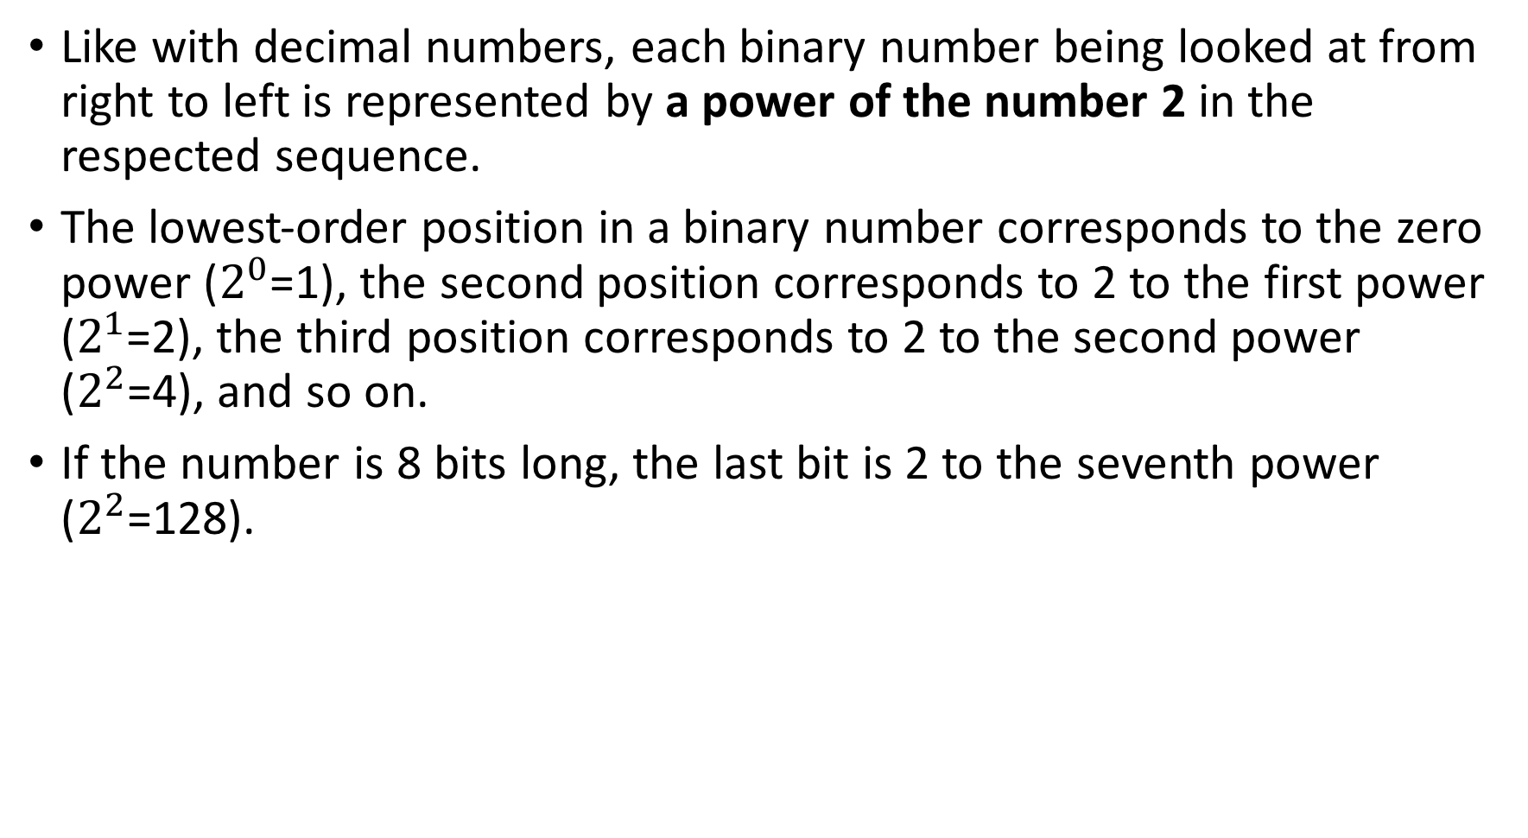
Like with decimal numbers, each binary number being looked at from right to left is represented by a power of the number 2 in the respected sequence.
The lowest-order position in a binary number corresponds to the zero power ($2^{0}$=1), the second position corresponds to 2 to the first power ($2^{1}$=2), the third position corresponds to 2 to the second power ($2^{2}$=4), and so on.
If the number is 8 bits long, the last bit is 2 to the seventh power ($2^{2}$=128).

Slide 13
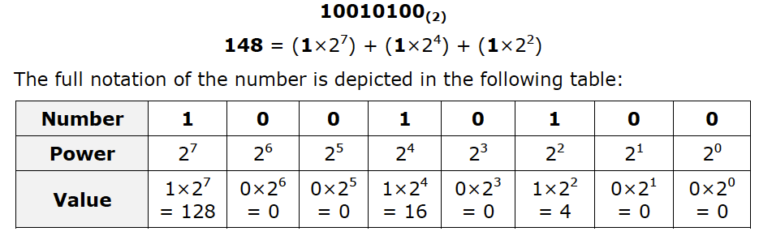
Example
Let’s look at some examples of numbers in the binary numeral system. Take, for example, the decimal number 148. It is composed of three digits: 1, 4 and 8, and it corresponds to the following binary number:

Slide 14
The sequence of eight zeros or ones represents one byte, an ordinary eight bit binary number. All numbers from 0 to 255 including can be represented in a single byte. In most cases this is not enough; as a result several consecutive bytes can be used to represent a big number. Two bytes form the so called "machine word" (word), which corresponds to 16 bits (in 16-bit computing machines). Besides it, computing machines use the so called double word or dword, corresponding to 32 bits.

Slide 15


Slide 16
Converting From Binary to Decimal Numeral System
When turning from binary to decimal numeral system, we do a conversion of a binary number to a decimal number.
Every number can be converted from one numeral system to another by doing a sequence of operations that are possible in both numeral systems.
As we have already mentioned, numbers in the binary system consist of binary digits, which are ordered by the powers of 2.

Slide 17
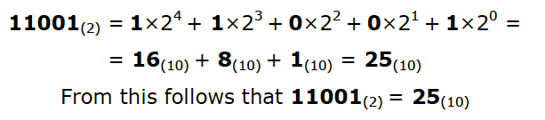

Example
Let’s take the number ${11001}_{(2)}$Converting into decimal is done by calculating the following sum:

Slide 18
In other words – every single binary digit is multiplied by 2 raised to the power of the position it is in. In the end all of the numbers resulting from the binary digits are added up to get the decimal value of the binary number.

Slide 19
Exercise
Convert the following binary numbers to decimal numbers
  1000111
  100101
  11011
  10110100
  1011

Slide 20
Converting from Decimal to Binary Numeral System
When transitioning from decimal to binary numeral system, we convert a decimal number into a binary one.
To accomplish this, we divide it by 2 with a remainder. This is how we get the quotient and the remainder, which is separated.

Slide 21
Let’s use the number 148 again as an example. We do an integer division by the base we want to convert to (in this case it is 2). After that using the remainders of the division (they will always be either zero or one), we represent the converted number.

Slide 22
We continue dividing until we get a zero quotient. Here is an example:
148:2=74 with remainder 0;
74:2= 37 with remainder 0;
37:2= 18 with remainder 1;
18:2= 9 with remainder 0;
9:2= 4 with remainder 1;
4:2= 2 with remainder 0;
2:2= 1 with remainder 0;
1:2= 0 with remainder 1;
After we are done with the division, we represent the remainders in reverse order as follows:
10010100
i.e. 148(10) = 10010100 (2)

Slide 23
Exercise
Convert the number
151
35
43
251
1023
1024
To the binary numeral system

